Slide 1



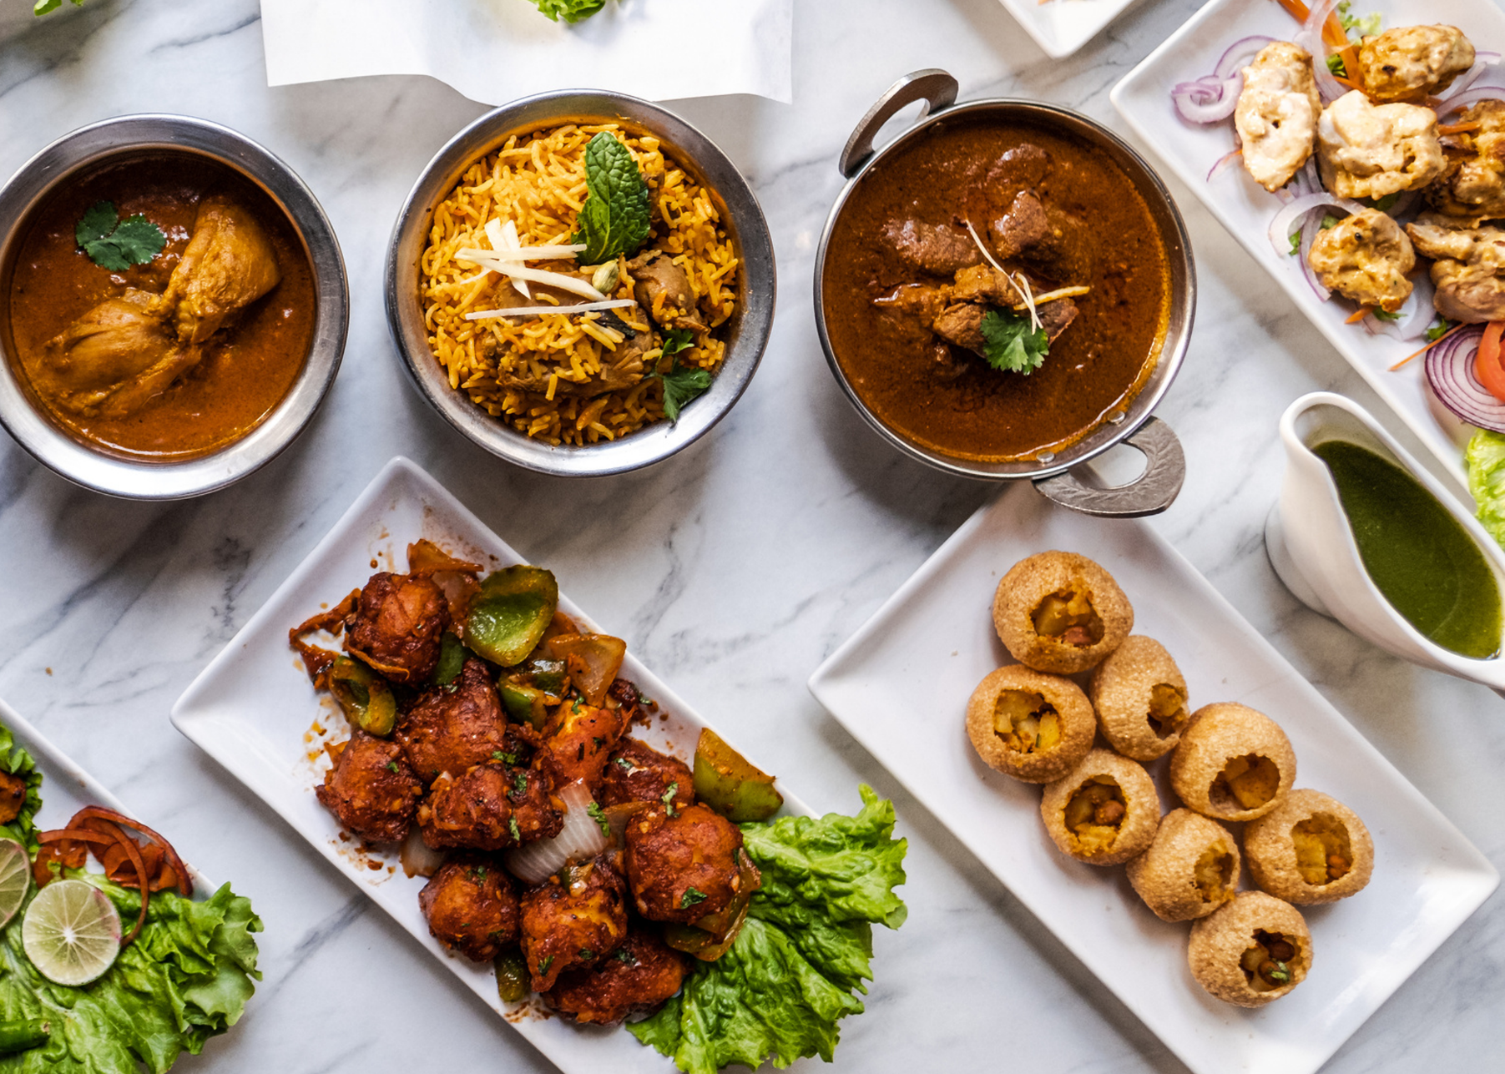
Mini Project-I (K24MCA18P) Odd Semester Session 2024-25
FOODIESTAMP
EXPLORE,EAT,REPEAT
JATIN GUPTA 2426MCA663
KUMAR KASHYAP 2426MCA412
DIVYAM RAJ 2426MCA1749
Project Supervisor:
Supervisor Name : Mr Arpit Dogra
Designation : Assistant Professor

Slide 2
INTRODUCTON
Building a Global Food Community Connects food enthusiasts worldwide, creating an inclusive space for sharing culinary experiences.
Discover Restaurants & Dishes Helps both casual diners and seasoned food critics find new dining spots and exciting dishes.
Recipe Sharing Platform Allows users to share favorite recipes and explore new ones from diverse cuisines.
Food Culture & Education Provides insights into global food traditions, ingredients, and cooking techniques, enriching culinary knowledge.
Document Your Food Journey Enables users to log and share their food experiences, from restaurant visits to home-cooked meals.
Making Food Exploration Fun & Accessible Simplifies food discovery, making it an enjoyable and accessible adventure for everyone.

Slide 3
LITERATURE REVIEW
The Rise of Food Communities in the Digital Age
Online Food Communities
Platforms facilitating food-related content have increased engagement among users (Kim & Johnson, 2016).
FoodieStamp aligns with this trend by creating a global network for food enthusiasts to connect, share, and explore.
Social Interaction through Food
Digital spaces around food promote social interaction, and food has become a form of personal expression (Johnston & Baumann, 2015).
FoodieStamp allows users to share and document their unique food journeys, fostering community building around culinary identity.

Slide 4
LITERATURE REVIEW (CNTD)
Social Interaction through Food
Digital spaces around food promote social interaction, and food has become a form of personal expression (Johnston & Baumann, 2015).
FoodieStamp allows users to share and document their unique food journeys, fostering community building around culinary identity and creates a sense of belonging.
Recipe Sharing and Culinary Knowledge
Digital Recipe Sharing
Online platforms have revolutionized how recipes are shared, turning cooking into a communal experience (Epp & Price, 2008).
FoodieStamp supports recipe sharing, enabling users to discover new cuisines and share their favorite recipes with the global community.
Impact on Home Cooking
Access to diverse recipes promotes at-home experimentation and broadens culinary skills (Schneider, 2019).
By fostering recipe exchange, FoodieStamp encourages users to explore cooking from different cultures, enhancing food literacy.

Slide 5
OBJECTIVE
Build a Global Food Community Platform
Develop a scalable, interactive platform where users can connect, share content, and engage with a worldwide community of food enthusiasts.
Enhance Food Discovery with Personalized Features
Implement personalized algorithms for recommending restaurants, dishes, and dining experiences based on user preferences and past interactions.
Promote Culinary Education through Engaging Content
Create a user-friendly interface that provides educational content on global food traditions, ingredients, and recipes through blogs, videos, and interactive features.
Facilitate Seamless Recipe Sharing
Enable a smooth, intuitive process for users to share and discover recipes with rich media (images, videos, step-by-step guides) across different devices.
Develop User Profiles for Documenting Food Journeys
Build robust user profiles where individuals can log their food experiences, upload photos, rate restaurants, and share reviews.
Foster Food Culture Awareness with Interactive Elements
Integrate multimedia features (videos, infographics, and cultural insights) to educate users about the cultural significance of different foods and cuisines.
Ensure Accessibility and Enjoyable User Experience
Prioritize responsive design and accessibility, ensuring the platform is enjoyable and easy to use across all devices (desktop, mobile, tablets) for users of all skill levels.

Slide 6
TECHNOLOGY (HARDWARE REQUIREEMTS)
Development Environment:
Personal Computers/Laptops
Minimum specifications
Processor: Intel i5 or equivalent
RAM: 8 GB or more
Storage: 256 GB SSD or higher
Client Requirements :
Personal Computers/Laptops
Minimum specifications
Processor: Intel i3/i5 or equivalent
RAM: 8 GB or more
Storage: 256 GB SSD or higher

Slide 7
TECHNOLOGY (SOFTWARE REQUIREEMTS)
Frontend Technologies:
HTML/CSS: For structuring and styling the web pages.
JavaScript: To create interactive elements on the platform.
React.js: A JavaScript library for building user interfaces, providing a dynamic and responsive experience.
Backend Technologies:
MongoDB: A NoSQL database for storing product listings, user data, and transaction records, enabling flexible data management.
Node.js: A JavaScript runtime for building server-side applications, allowing for efficient handling of requests.
Browsers: Google Chrome/Edge/Firefox
IDE: VS Code , NodeJS

Slide 8
A back-end module for platform management, including user moderation, content curation, and data analytics.
MODULES
User Authentication Module : Handles user registration, login, password recovery, and profile management.
Food Discovery Engine: A module for discovering restaurants, dishes, and dining experiences, with filters and personalized recommendations.
Culinary Education and Food Culture: An educational module with articles, videos, and infographics on global food traditions, ingredients, and cooking techniques.
Recipe Sharing Platform: A space for users to upload, share, and browse recipes with options for images, videos, and step-by-step instructions.
Ratings and Reviews: A review system where users can rate restaurants, dishes, and recipes, and provide feedback to help others in the community.
Admin Panel Module : Enables administrators to manage users, products, transactions, and monitor recycling operations.
Food Journey Documentation: A feature for users to log and document their food experiences, including restaurant visits, home-cooked meals, and reviews.

Slide 9
WORKFLOW
1
Request Handling
3
Admin Dashboard
5
Recipe Sharing
2
4
6
User Interaction
Data Storage & Management
Real-Time Updates

Slide 10
REPORTS

Slide 11
REFRENCES
W3Schools:"HTML, CSS, JavaScript, and More." Access comprehensive tutorials and resources on web development technologies at W3Schools.
GeeksforGeeks:"Understanding the Circular Economy and Its Impact." Explore articles on sustainability and coding practices at GeeksforGeeks.
MDN Web Docs:"Web Development Documentation." Find detailed documentation and guides on web technologies at MDN Web Docs.
FreeCodeCamp:"Learn to Code for Free." Access a variety of coding tutorials and projects, including e-commerce solutions, at FreeCodeCamp.
Stack Overflow:"Community Q&A for Developers." Get answers to coding questions and challenges related to your project at Stack Overflow.

Slide 12



THANK YOU FOR YOUR ATTENTION

